Slide 1
Coordination Committee Meeting
April 20th, 2023
Strengthening conversation between civil society, Europe and the World

Slide 2
Agenda
Stockholm Amendment update
Preparations for our event during future Presidencies of the Council of the European Union
Preparations for the World Health Summit 2023, October 15-17
Reinforcing OEGH : LinkedIn and Letter of Commitment

Slide 3
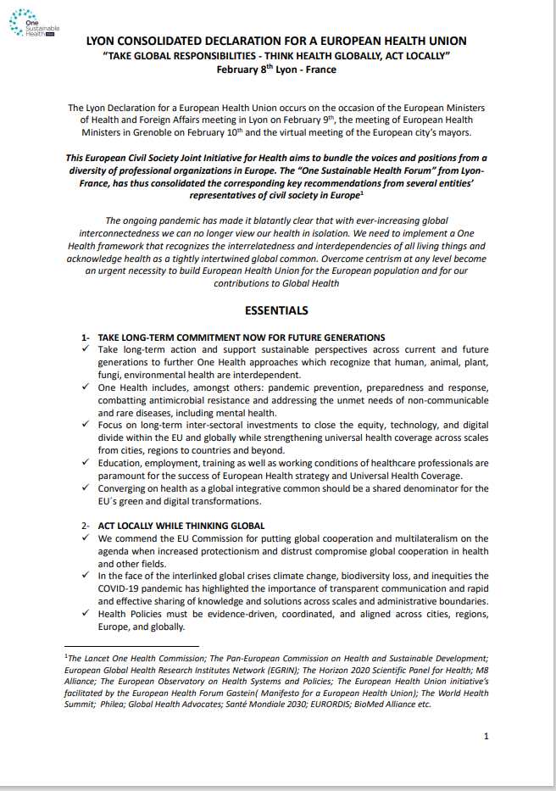
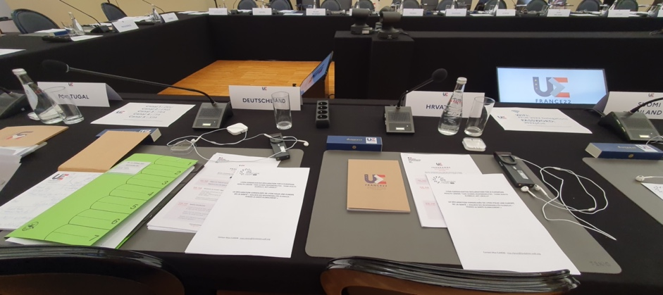
ONE EUROPE FOR GLOBAL HEALTH DECLARATION
Feb 8, 2022
Make a long-term commitment to future generations, to enhance preparedness and build more resilient societies
Think and act globally, regionally and locally – a “glocal” approach
Come together in equity and solidarity within Europe and beyond
Limit silos with more intersectoral cooperation
Commit to good governance for a European Health Union
h

Slide 4
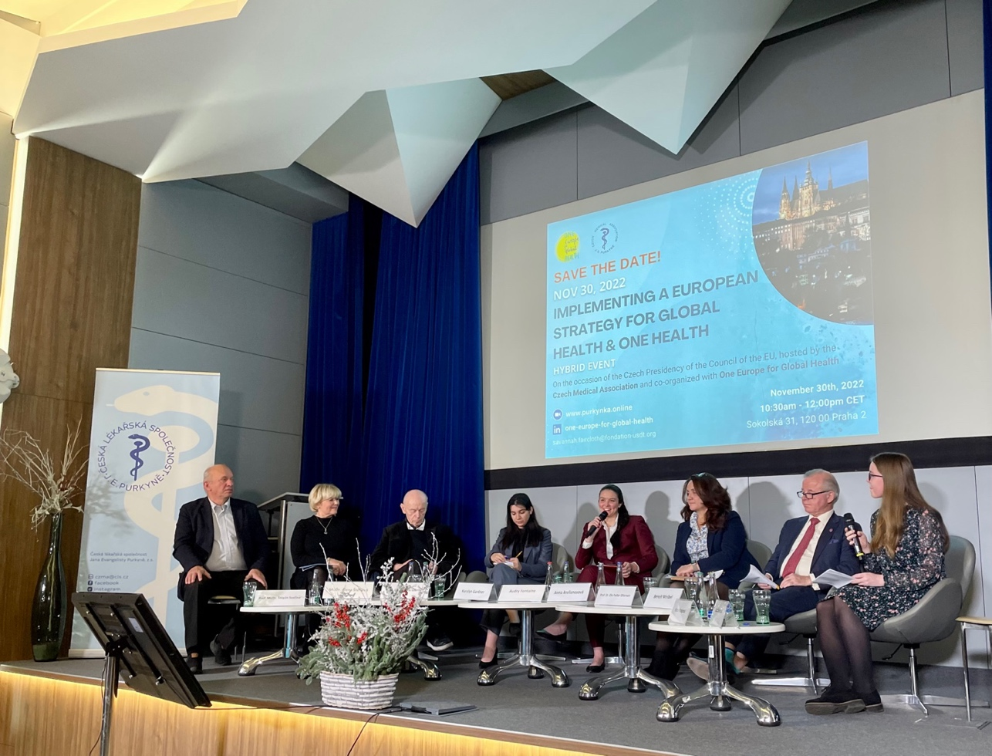
Prague Amendment¹
Highlights:
Consistency and Clarity for governance & financing in One health and Global Health
Highlight importance of environmental health in Global health efforts
Center youth involvement to ensure sustainability in European health policies
1: October 30, 2022

Slide 5
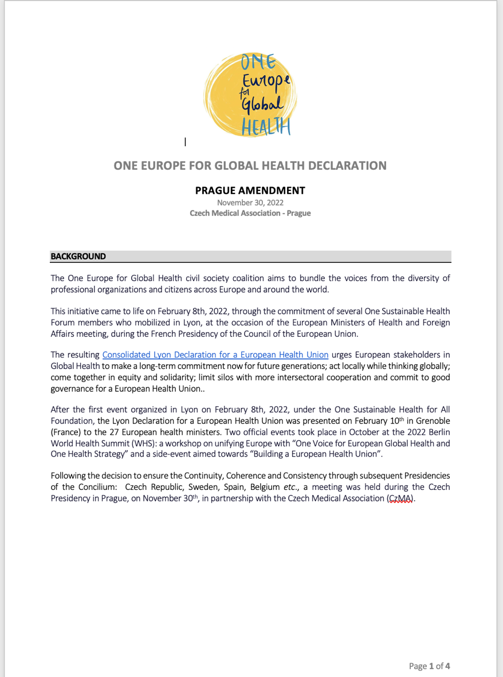
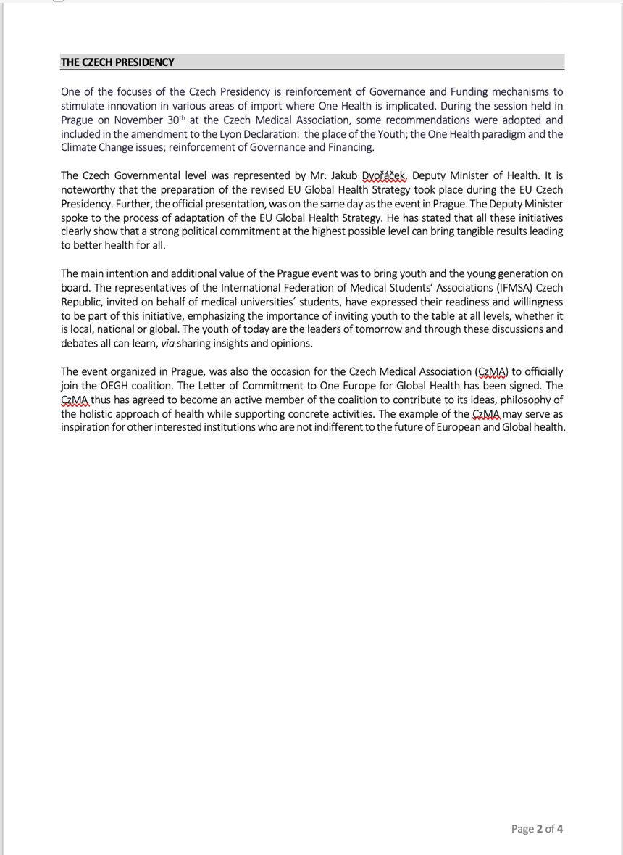
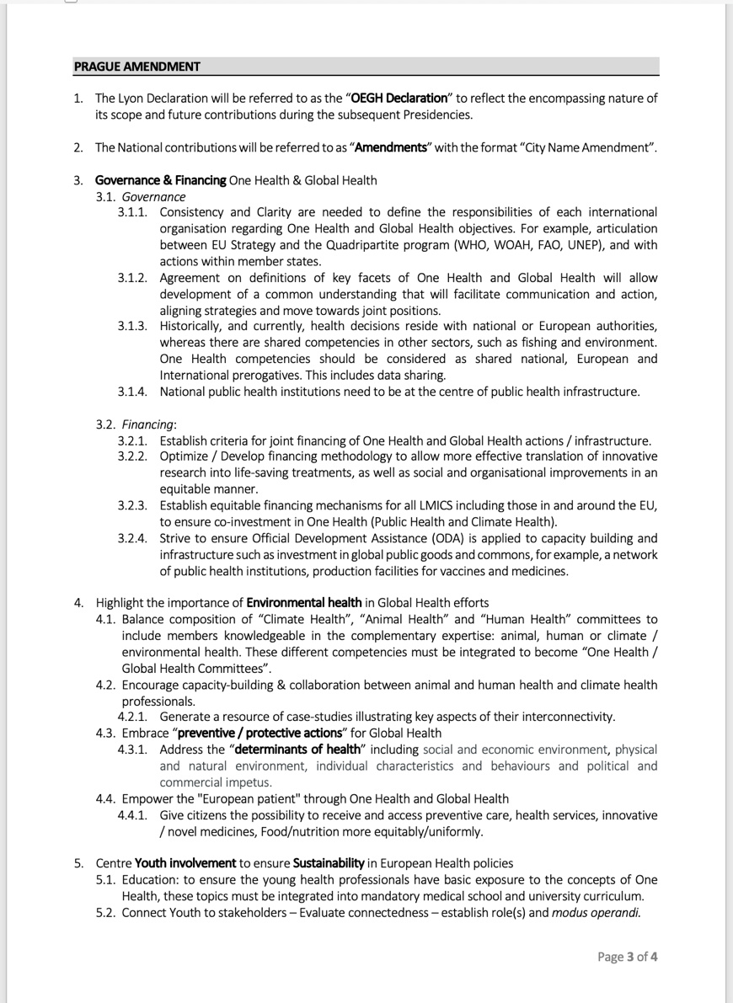
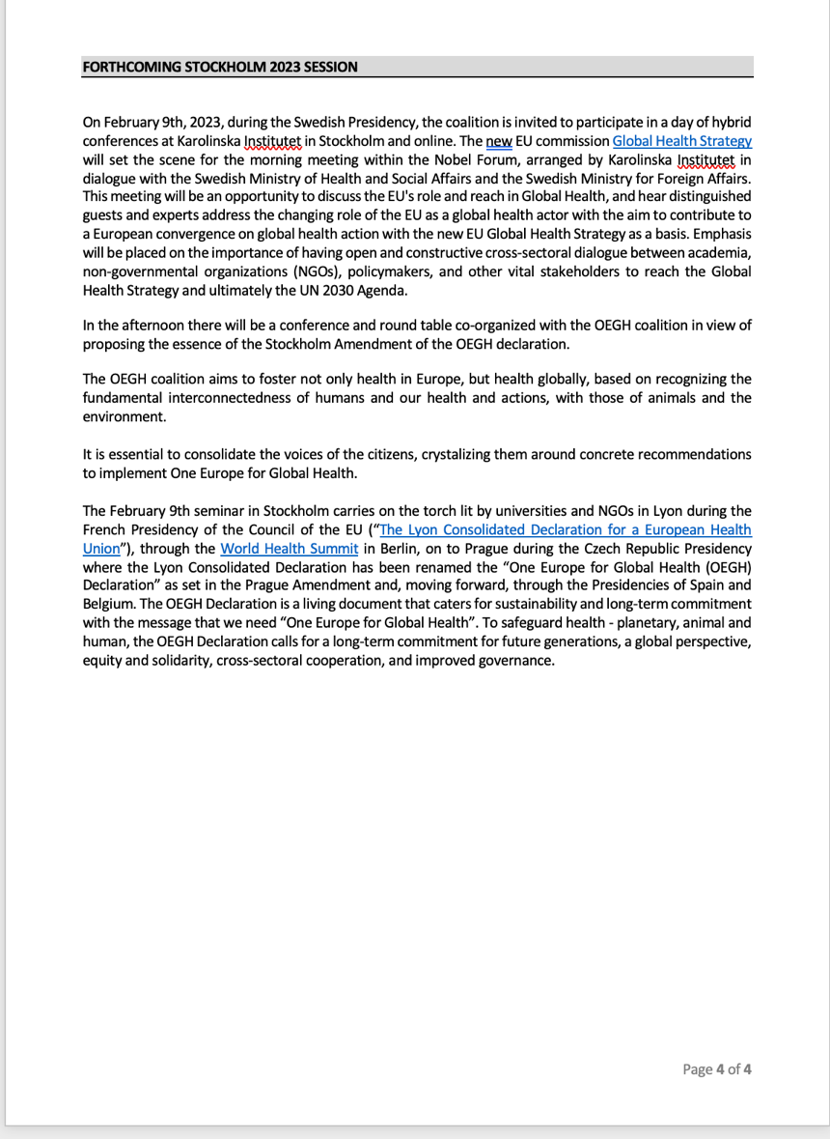
Prague Amendment
Template:
Background OEGH
Country PRESIDENCY
AMENDMENT DETAIL
Future PRESIDENCY

Slide 6
One Europe for Global Health Declaration
Prague Amendment (October 30, 2022)
CZECH MEDICAL ASSOCIATION
Stockholm Amendment (February 9, 2022)
KAROLINSKA INSTITUTET
Spain Amendment (S2 2023)
Belgium Amendment (S1 2024)

Slide 7
STOCKHOLM SESSION – FEB 9, 2023
9 February afternoon “Chatham House” roundtable:
“Implementing the new EU Global Health Strategy: From Coal and Steel to one heath and green deal – Convergence on Global Health”
Roundtable discussion: Towards a Stockholm Amendment with the aim of operationalizing the new Global Health Strategy (2022)
Chaired by Ole Petter Ottersen, President - Karolinska Institutet
Moderated by Stefan Swartling Peterson, Professor of Global Transformation for Health, Karolinska Institutet

Slide 8
1. Stockholm EVENTs
Roundtable discussion Thursday, February 9th
Stockholm Amendment writing workshop Friday, February 10th

Slide 9
1. Stockholm amendment BMJ Article
BMJ communication to be published thanks to efforts of "Team KI” reflecting the essence of the discussions resulting in the Stockholm Amendment

Slide 10
1. Stockholm amendment (Draft)
Stockholm Amendment: list of recommendations compiled from the Conference and Roundtable on February 9th.

Slide 11
1. Stockholm amendment PRIORITIES
HUMAN RIGHTS, SOLIDARITY, EQUITY, INCLUSION AND EQUAL PARTNERSHIPS
IMPLEMENT ONE HEALTH
INTEGRATE ONE HEALTH INTO TRADE AND ECONOMY
YOUTH

Slide 12
2. presidencies of the Council of the European Union
Source : https://en.wikipedia.org/wiki/Presidency_of_the_Council_of_the_European_Union

Slide 13
2. presidencies of the Council of the European Union
Source : https://en.wikipedia.org/wiki/Presidency_of_the_Council_of_the_European_Union

Slide 14
2. PREPARATION FOR UPCOMING PRESIDENCIES SpaIN
S2 2023
INSTITUTE OF GLOBAL HEALTH
BELGIUM
S1 2024

Slide 15
3. World Health Summit 2023, October 15-17
1 OEGH Side Event (+ 1 OSH Forum Workshop in the main program)
Side Event working title: “Together, civil society and member states, strengthening the GH and OH actions from Europe.”
Working on deciding chair and speakers

Slide 16
4. Reinforcing OEGH : Linkedin and Letter of Commitment
Please take the time to sign and return the Letter of Commitment sent to you today.
Reminder to follow One Europe for Global Health on LinkedIn AND invite your contacts to follow!
Our coalition is always open to welcome new partners, if you know of someone or an organization, who would be interested in the adventure.

Slide 17
THANK YOU!
Savannah Faircloth – OEGH Project Officer
savannah.faircloth@foundation-usdt.org

Slide 18
MISSION STATEMENT
“The mission of the One Europe for Global Health coalition is to improve and integrate global health and One Health priorities into European policies, strategies and actions by convening actors of European civil society.”

